Slide 1

Student Performance Analysis
Presented by: SHAHIN SULAIMAN M
Date :11-12-2024

Slide 2
Introduction
Objective:
To analyze key factors affecting student performance.
To identify trends and actionable insights.
Dataset:
Source of the dataset (e.g., school records, survey data).
Overview of data (e.g., number of students, features like age, grades, attendance).

Slide 3
Dataset Overview
Key Features:
Student demographics (e.g., age, gender, city).
Academic data (e.g., grades, attendance).
Additional factors (e.g., extracurricular activities, parental support).

Slide 4
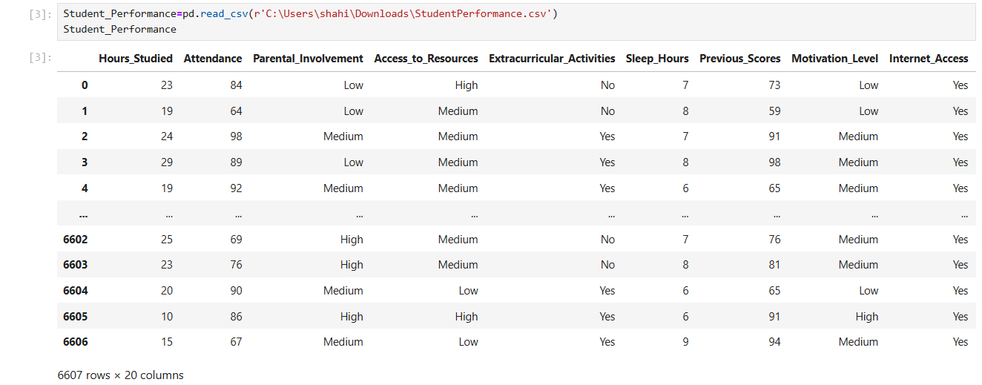

Slide 5
Exploratory Data Analysis (EDA)
Summary Statistics:
Average grades, attendance rate, etc.
Visual Insights:
Histogram of grades.
Pie chart of gender distribution.
Missing Data:
Overview of missing data.

Slide 6
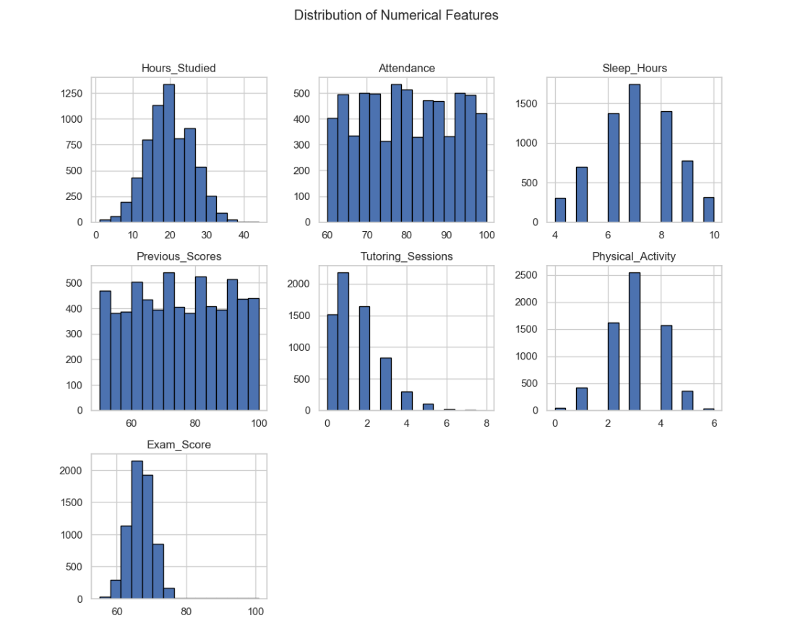

Slide 7
Factors Affecting Performance
Key Correlations:
Grades vs. Attendance.
Influence of parental support or extracurricular activities.
Visualizations:
Scatter plots, bar charts, or heatmaps to show correlations.

Slide 8
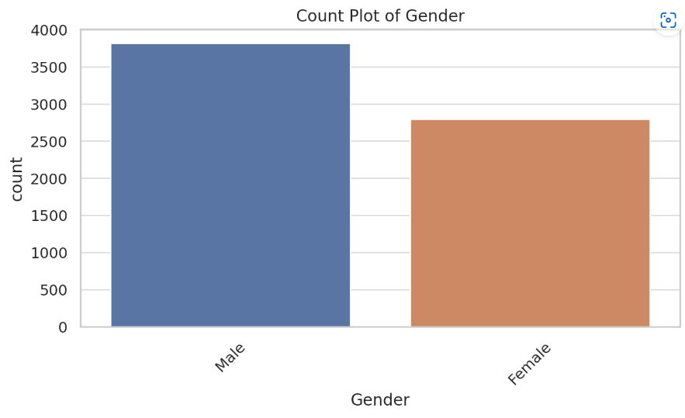
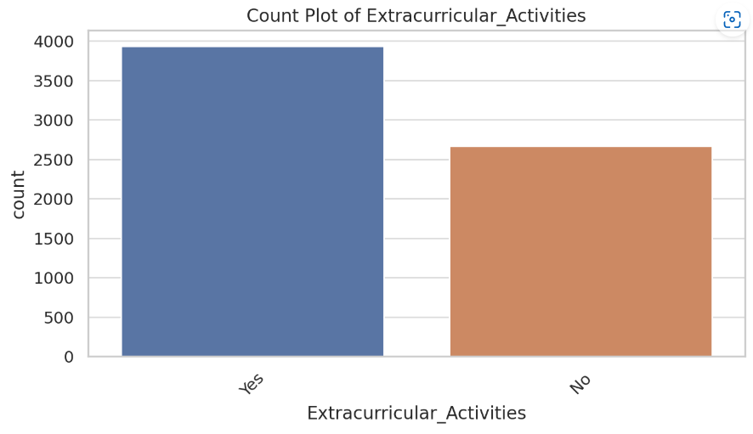

Slide 9
Statistical Analysis
Correlation Matrix:
Highlight relationships between numeric variables (e.g., attendance and grades).
Insights:
"High attendance correlates positively with better grades."
"Parental involvement shows moderate influence on student performance."

Slide 10
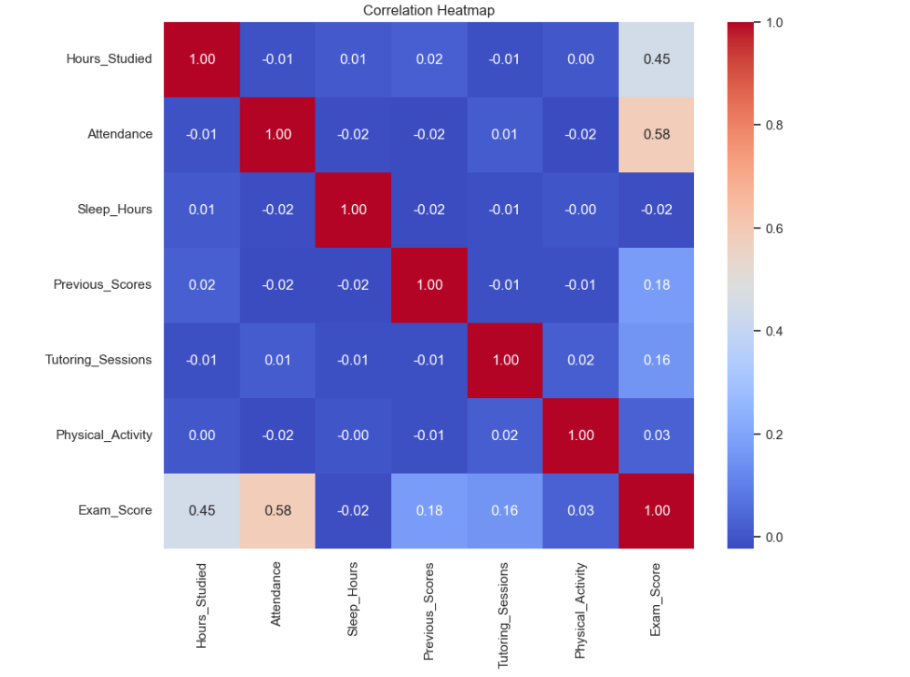

Slide 11
Key Findings
"Students with higher attendance perform better academically."
"Parental support plays a significant role in student success."
"Extracurricular activities correlate with improved academic outcomes."

Slide 12
Recommendations
For Students:
Prioritize regular attendance.
Engage in extracurricular activities.
For Educators:
Identify and support struggling students early.
Foster parental involvement.
For Parents:
Provide consistent support and encouragement.

Slide 13
Conclusion
Restate key findings and their implications.
Discuss limitations of the analysis.
It will Suggest areas for future research or improvements.

Slide 14


